Slide 1
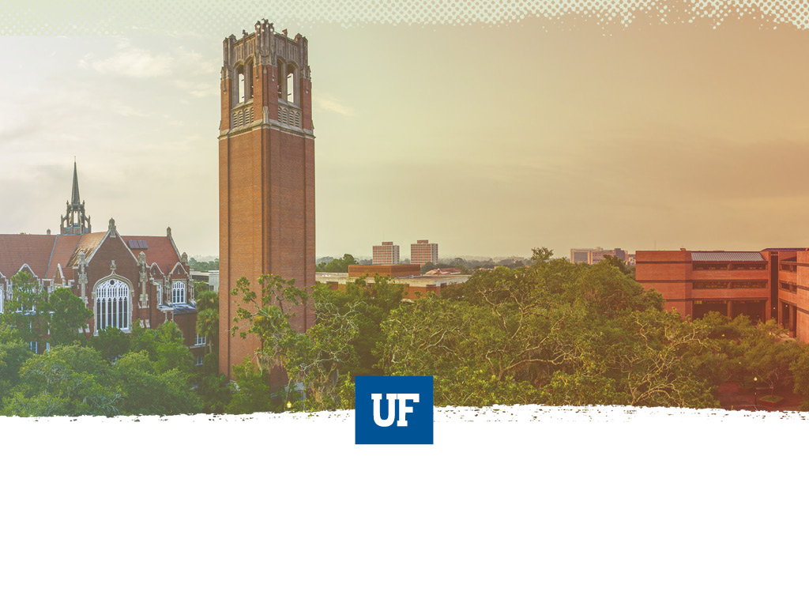
UF Quest Curriculum Committee
Angela S. Lindner, Chair
Associate Provost
UF Undergraduate Affairs Environmental Engineering Sciences
Trysh Travis, Co-Chair
UF Quest Faculty Liaison
Center for Gender, Sexualities, and Women’s Studies

Slide 2

Agenda
Welcome and Introductions
Brain-storming Exercise
Where We Have Been and Where We Are
Where We Are Going
Subcommittee Interactive Exercise
Questions and Responses and Closing
Logo Design: Maria Pitt, UF 2016

Slide 3
Brainstorming Activity

Slide 4
2010
2011
2012
2013
2014
2015
2016
2017
2018
Where We Have Been and Where We Are Now
“This assessment will ensure that we continue to move forward in the process of actualizing the vision of undergraduate education at the University of Florida. Namely that, ‘University of Florida graduates will have a well-developed capacity for intellectual inquiry, demonstrated competency in a chosen discipline, and a strong sense of personal, social, and global responsibility’.”
-2010 UF Undergraduate Task Force Report

Slide 5
2010
2011
2012
2013
2014
2015
2016
2017
2018
2010 Task Force on Undergraduate Education
Work towards creation of a signature experience for FTIC students with themed approach and electronic portfolios
Use themed signature program to develop specific leadership opportunities for juniors and seniors
Increase opportunities for experiential learning
  Assist development of, promotion of, oversight of, and accountability for interdisciplinary, creative and research-oriented studies
Incorporate service learning and civic engagement goals into theme-based curriculum
http://fora.aa.ufl.edu/docs/56/UGTaskForceReport.pdf

Slide 6
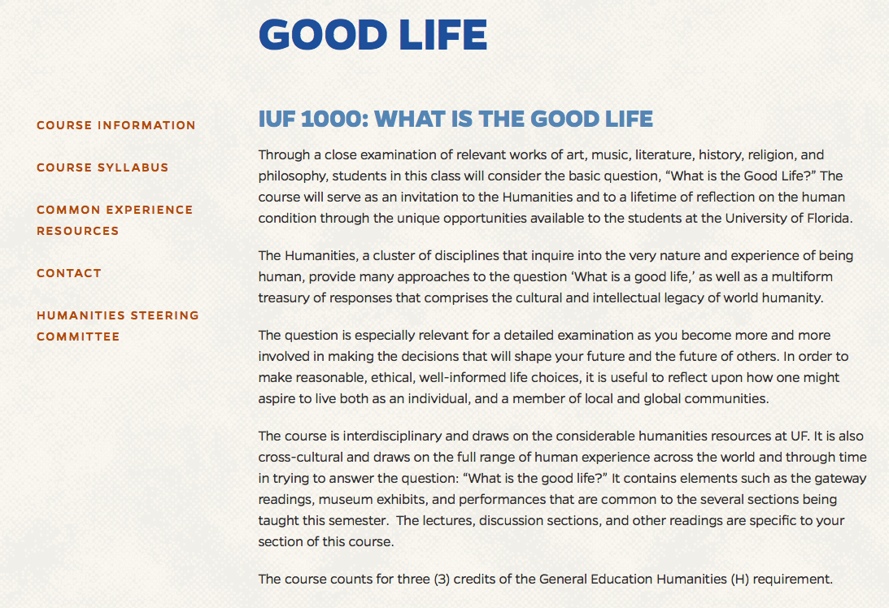
2010
2011
2012
2013
2014
2015
2016
2017
2018
“What Is the Good Life” First Piloted in Fall 2010
UF General Education Task Force Recommends “What Is the Good Life” Course, Fall 2011
http://fora.aa.ufl.edu/docs/57/Gen_Ed-Humanities_Final_Report.pdf

Slide 7
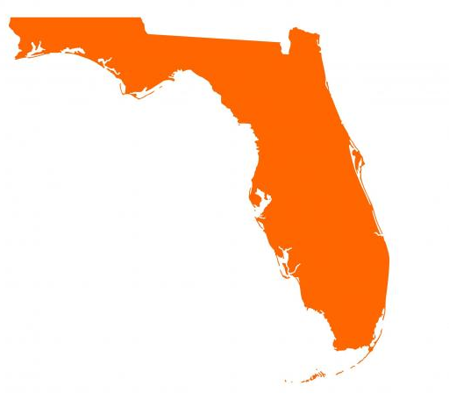
2010
2011
2012
2013
2014
2015
2016
2017
2018
Pre-eminence Legislation
“In order to provide a jointly shared educational experience, a university that is designated a preeminent state research university may require its incoming first-time-in-college students to take a 9-to-12- 6-credit set of unique courses specifically determined by the university and published on the university’s website. The university may stipulate that credit for such courses may not be earned through any acceleration mechanism…or any other transfer credit.”
Florida Statute 1001.7065, 2013, 2016

Slide 8

2010
2011
2012
2013
2014
2015
2016
2017
2018
Grand Challenges CFP, November 2013
http://gened.aa.ufl.edu/Data/Sites/10/media/grand_challenges/uf-core-description.pdf

Slide 9
2014
2010
2011
2012
2013
2015
2016
2017
2018
Climate Change and Big Data Courses Selected , Spring 2014
Courses Piloted, 2015
IUF1000: “What Is the Good Life?”
(H, 3 CH)
“The Challenge of Climate Change”
(B/P, 3 CH)
“An Informed Life: People and Data”
(S, 3 CH)
All FTIC students take all 3 courses
Total of 9 credit hours
In addition to other UF and statewide general education requirements
All courses completed within the first two years

Slide 10
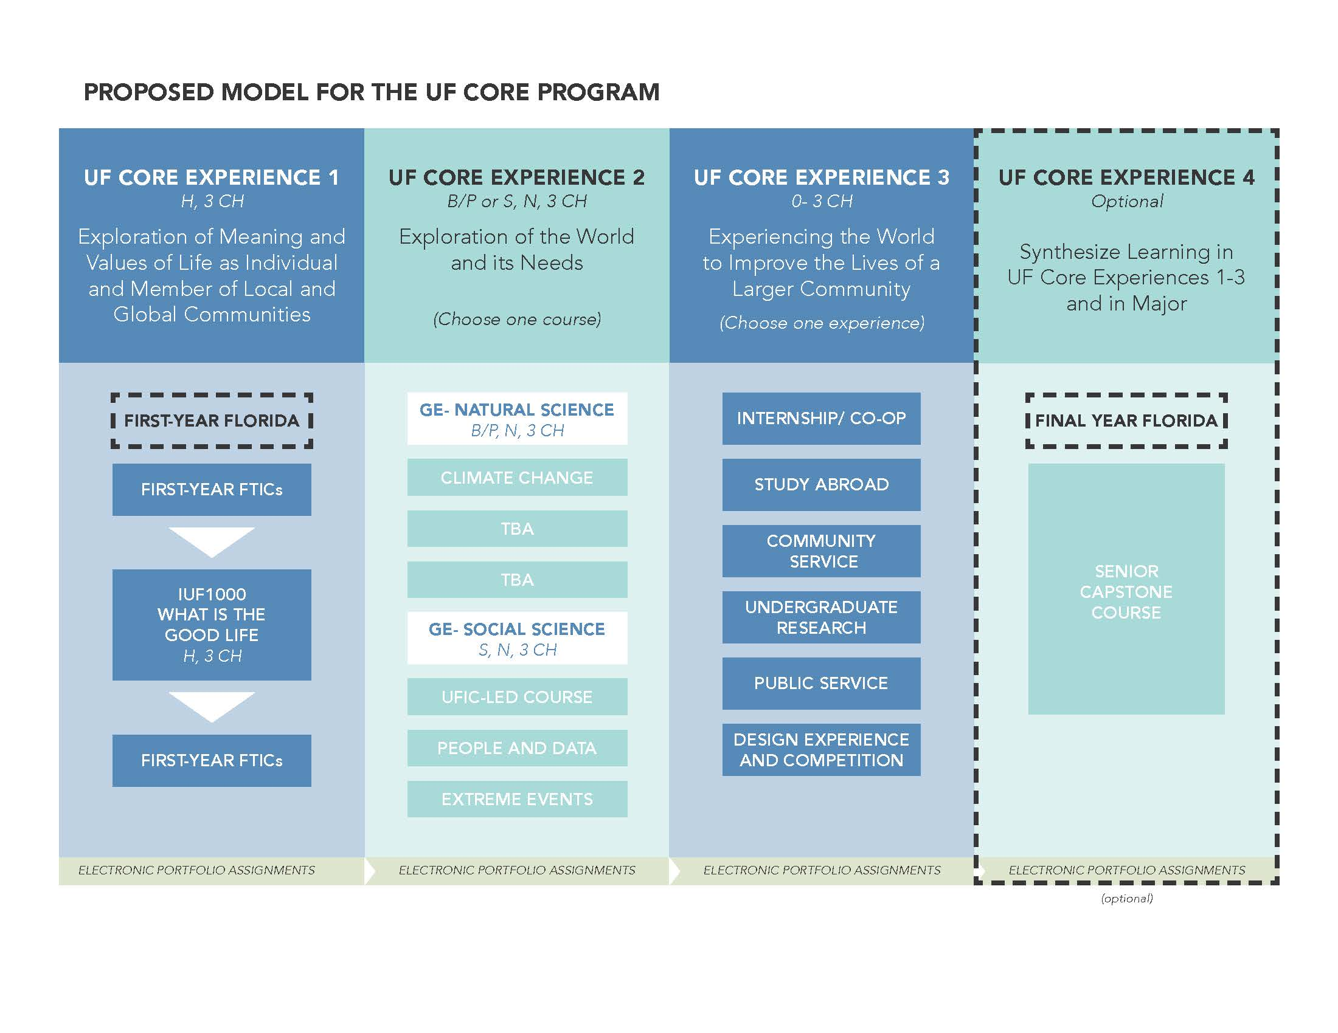

2011
2014
2015
2016
2017
2018
2010
2012
2013
New Model Proposed, Spring 2016
UF Quest Task Force Work and Multiple Forms of Feedback, 2016-2017
Task Force 1 Chair:
Dr. Andy Wolpert, CLAS
Task Force 2 Chair:
Dr. David Miller, COE
Task Force 3 Chair:
Dr. Chris Hass, HHP
Task Force 4 Chair:
Dr. Elayne Colon, COE

Slide 11
2010
2011
2012
2013
2014
2015
2016
2017
2018
CLAS Working Groups and UF Quest Task Forces Combined, Faculty Senate Presentations, and Faculty Survey, Spring 2017

Slide 12
2010
2011
2012
2013
2014
2015
2016
2017
2018
Combined Working Groups’ Reports Released, Spring 2017
http://undergrad.aa.ufl.edu/uf-quest/

Slide 13
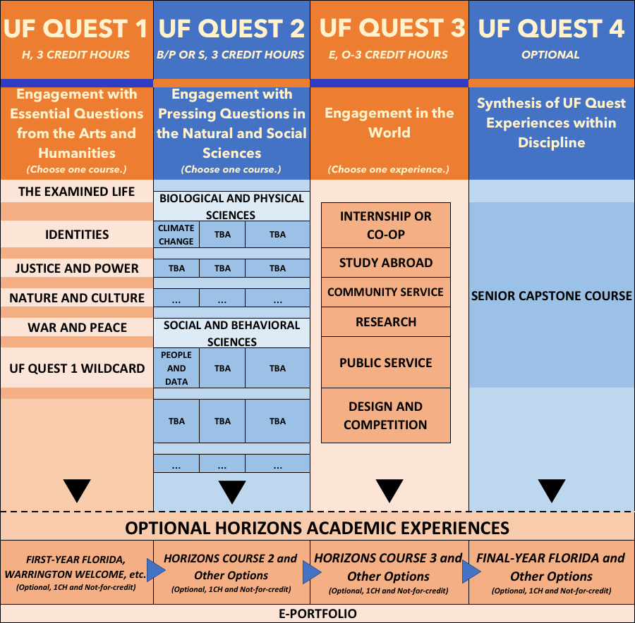
2018
2010
2011
2012
2013
2014
2015
2016
2017
Current UF Quest Framework, Spring 2018

Slide 14
2018
2019
2020
2021
2022
2023
2024
2025
2026
Where We Are Going
“By posing the unanswerable questions of meaning, people establish themselves as question-asking beings. Behind all the cognitive questions for which people find answers, there lurk the unanswerable ones that seem entirely idle and have always been denounced as such.” –Hannah Arendt, The Life of the Mind

Slide 15
Many Roads, One Journey
“Every undergraduate deserves an invitation to be personally engaged by an expert teacher in a serious conversation about how to answer the question of “what does it all mean?’—however that question is posed in any given field.”**
“Curricular reform should be driven by faculty expertise and student choice.” **
“Quest 1 courses take a specific theme as a special focus and use it as a way to see how the humanities disciplines help in addressing essential questions that arise when people pause to consider how they should see their place in the world and what they should do about it.”*
“Quest 2 Courses should describe and explain the cross-disciplinary aspects of a pressing societal problem or challenge and demonstrate the kinds of questions that are asked and answered by natural and/or social scientists.”*
* Working Group Reports
** Remarks at CLAS Assembly, Nov. 2016
Notes:
What does this look like in practice? Will talk about the nuts and bolts of how to create a Quest course, but here are some examples

Slide 16
Traditional and Quest Class, Humanities
(Theme: Identities)
AMH3340, History of Disability in America
This course will be both chronological and topical in nature, examining particular disabilities and their treatment over time. We will also look at the medical, legal, and social contexts in which disabilities exist. The course will investigate the relationship of governmental policy and its effects on the lives of persons with disabilities. Finally, we will examine the social construction of disabilities and how new conditions are “discovered,” labeled, and treated. This is a course about both persons with disabilities and how these individuals have been treated by “normal” Americans throughout American history. We will focus on how the issues of disabilities relate to major themes in American history.
Quest 1 (Identities), History of Disability in America
This is a course about both persons with disabilities and how these individuals have been treated by “normal” Americans throughout American history. At the heart of the class are two linked questions: what is “normal” and who gets to decide that? And how have ideas of what is physically and mentally “normal” changed over time in the US?
We will class explore these questions by reflecting on our own experiences with “normalizing” discourses; looking at the evolving medical, legal, and social contexts in which disabilities exist; and engaging with representations of disability (in photography, literature, and film) from the 19th century to the present.
Notes:
Here you see very clearly the multidisciplinarity and the engagement with “essential questions.” One thing key is the orientation of the course away from advancing the discipline or major, and towards advancing the students’ own thinking about the world.

Slide 17
Traditional and Quest Class, Natural Science
BSC 2862 Global Change Ecology and Sustainability
This course uses ecological concepts to discuss major anthropogenic driven changes that are occurring globally. Fundamental concepts discussed include changes in land use, alterations in the water, nitrogen, phosphorus, and carbon cycles, climate change, redistribution of species, loss of biodiversity, and species extinctions. An additional goal is to evaluate best management practices, technologies, policies, and human behavior that can result in minimizing negative human impacts on the biosphere and promote sustainability. This course also strives to develop critical thinking skills for development of reasoned thought and for evaluation of life experiences.
Quest 2 Global Change Ecology and Sustainability
What is the human role—your role– in global environmental change? In creating “sustainability”? This class examines the human-environmental interface from an ecological perspective, and engages students by requiring site visits and analysis of personal consumption and waste as well as reading in current science and best management practices.
Fundamental concepts discussed include changes in land use, alterations in the water, nitrogen, phosphorus, and carbon cycles, climate change, redistribution of species, loss of biodiversity, and species extinctions.
Notes:
In this natural science class, the student is centered in the field-based knowledge. Time is taken away from coverage, it’s true, but the material is not “dumbed down.” Instead, a set of issues that professionals already know how to engage—and that the traditional course would be training majors to engage– are presented in a way that the average non-specialist student can engage them.

Slide 18
Traditional and Quest Class,
Social Science
SYA 4930, Social Movements
The goal of this course is to equip students with the intellectual tools and ability to understand the myriad groups who come together to work for social change. The course begins with a broad overview of the ways we study social movements: the theories and issues at hand. From there, the course moves into studying select movements, where we will apply and interrogate the applications of each perspective.
Quest 2, Social Movements
Mid-century Civil Rights activists created a template through which most Americans understand social movements: they are principled and organized bids for recognition by groups forced to the margins. But this understanding of popular politics is actually relatively new-- it is also quite fluid. This class examines the way social movements have been understood since the late 19th century, asking where the desire to understand them came from, what purposes it has served, and how the people who participate in them understand their actions.
Students will examine their own participation in crowds and/or movements (virtual or face-to-face) and compare their experiences to those of classic theorists of social change and populism.
Notes:
Finally, here’s a high-level course on a real “ripped from the headlines” topic, repurposed so that it can be engaged with by anyone who has a twitter account.

Slide 19
Year 1 Trial Quest: Spring ‘19
Small pilot, 8-10 courses (CLAS, COTA, DCP)
  Substitutes for IUF1000
Fit within the 5 themes
“Freshman Friendly”
  No prereqs
  Rigorous but manageable workload
  Appropriate level of sophistication
  Most likely existing Hum Gen Eds
Taught by strong, undergrad-friendly faculty
F2F sections of 49
→ Information on what it feels like to generate and teach a Quest 1 Class that informs next stages
March: Subcommittee Year 1 drafts CFP
1st Week April: QCC approves
1 May: Proposals due
15 May: Instructors and departments notified
Notes:
The classes you dreamed up at start of meeting is one way to make Quest classes appear– and a key one. But the Working Groups pointed out last year that there are many outstanding classes currently on the books that could be tweaked—as these 3 examples were– to serve the purposes of Quest. That insight has led us to the structure of what we’re calling Trial Quest: a pilot that will run in Spring ‘19. Advancing us towards that Pilot will be the chief work of the Year 1 subcom this term.

Slide 20
Spring 2018 Timeline
Outcomes:
Full QCC Meetings: Orient members to their roles, to Spring 2018 and longer-term goals of QCC
Subcommittee 1: Develop and approve SLOs, objectives, and a temporary CFP for Trial Quest 1 courses
Subcommittee 2: Initiate development of SLOs, objectives, and CFP for Quest 2 courses
Two Full QCC Meetings
(2/16, 2/23)
Two Subcomm Meetings
(March)
Full QCC Meeting
(First Week of April)
Quest 1 Subcomm Meeting
(First Week of May)
Full QCC Meeting
(First Week of May)
Partner with PI’s in Course Development
(May-Dec)
Pilot Trial Quest courses
(Spring 2019)
Outcomes:
Release CFP for Trial Quest 1 courses (April 15)
Receive proposals (April 30)
Select (first week of May) and announce trial Quest 1 courses (May 15)
Partner with PI’s to develop trial courses and monitor pilots
Continue development and subsequent release of full CFPs for Quest 1 and Quest 2 courses (Fall 2018)

Slide 21
2018-2020 Quest Course Timeline
Trial Quest 1
(Spring-Fall 2019)
Finalize, Release Quest 1 and 2 CFPS and Select Courses
(Fall 2018)
Develop/Pilot Quest 1 and 2 Courses
(Spring 2019-
Spring 2020)
UF Quest Launches
(Required for SSB/Fall 2020 FTICs)
Continue Course Development and Pilot Cycle
(Fall 2020 forward)
Notes:
An ambitious pace. Building on momentum generated by Working Groups, AL and I think we can make it happen. But we—and some of you, but not all, and not all the faculty– have been down in weeds of this project for awhile. So want to shift gears now to try and gauge where you all are at w/an “interactive exercise.” See handouts for Years 1 and 2 descriptions and objectives and SLOs.

Slide 22
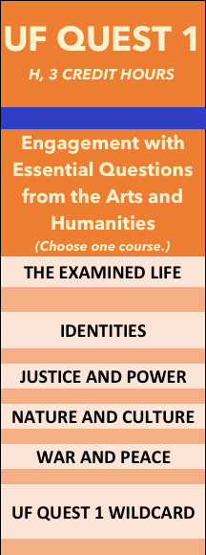
UF Quest 1 Draft SLOs
1. Content: Identify, describe, and explain the history, underlying theories, and methodologies used in and across the humanities disciplines present in the course
2. Communication: Communicate knowledge, ideas, and reasoning clearly and effectively in the written and oral forms appropriate to the humanities disciplines present in the course
3. Critical Thinking: Analyze and evaluate texts (visual, auditory, performed, and/or written) using established practices drawn from the humanities disciplines present in the course
4. Experiential Learning: Engage with at least one UF learning resource (e.g., Harn Museum, Philips Center or College of the Arts performance, Smathers Special Collections library, etc.) that reinforces or enhances materials present in the course
5. College readiness: Identify and analyze the distinctive features of college-level learning present in the course
6. Self-reflection: Identify, analyze, and reflect on personal ways of making meaning and creating value in the world; contrast those practices to those encountered in materials engaged within the course
Notes:
See handout on Years 1 and 2 for greater detail. I want to be clear about what you’re looking at. Wkg Group base, distilled and remixed by me w/input from Tigert, from Deans, from other stakeholders around campus. It’s a good faith effort to turn a bunch of people’s ideas about what should happen into a blueprint for how to MAKE it happen. But it didn’t come straight out of a faculty committee– I want to be clear about that.

Slide 23
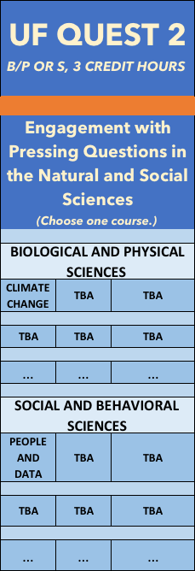
UF Quest 2 Draft SLOs
1. Content: Identify, describe, and explain the history, underlying theories, and methodologies used in and across the social and/or natural sciences disciplines present in the course
2. Critical Thinking: Propose and critically analyze an approach, policy, or action (grounded in theories, methodologies, and data) that addresses some aspect of a pressing societal problem or challenge
3. Communication: Present the proposed approach, policy, or action addressing the pressing societal problem or challenge at a general audience level
4. Experiential Learning: Culminate with the presentation of the project (e.g., poster, video, voiceover Powerpoint, debate) developed throughout the semester
5. College readiness: Identify and analyze the distinctive features of college-level learning present in the course
6. Self-reflection: Identify, analyze, and reflect on personal ways of addressing aspects of pressing societal problems or challenges; contrast those practices to those encountered in materials engaged within the course
Notes:
Here’s Year 2– you see again language from the Working Group report, comingled with other stuff on which the Working group was silent but that other stakeholders have identified as important. I’m presenting this to you today, heavily caveated, b/c we need to get a read on where this committee is at in terms of its thinking about the whole project in order to figure out how to most effectively move on. So instead of a Town Hall style meeting, where everyone shares feelings and opens up questions, I’m presenting these to you today as hypothetical working documents.

Slide 24
Subcommittee Interactive Exercise:
Where are We At?
This looks like a good distillation of what the Working Groups intended; I support their efforts and I think we can use these.
This looks decent and came from a good-faith place; it needs minor tweaks but then will be ready to use.
I have concerns about the process thus far and/or the outcome; further deliberation about these materials is needed before we can move forward.
If we wanted to write the Call for Proposals for Courses in Years 1 and 2 Trial today, what would you say?
Notes:
So here, and on handouts, are Working overviews of Years 1 and 2 (MY overviews, admittedly, but drawn primarily from the Working Group reports). And here’s the exercise: If we wanted…today.. What would you say? Are these general descriptions, objectives, and SLOs for Years 1 and 2 workable for a TRIAL as is? Are they pretty close, and workable with a few tweaks? Or– and this is not a rhetorical question– do you feel that either the PROCESS or the SUBSTANCE of where we are at right now is too dicey for us to move forward with these? Do we need to backtrack, deliberate more before we put together the call for proposals for Trial classes? Right now a million other questions about Quest as a whole; please bracket for now (put on paper for discussion next week) and just focus on this question: Is the picture of Year 1 and of Year 2 that you have on your handout solid enough that you are ready to think about launching a Trial, or are there still too many unknowns. Sub-com leaders will lead you in discussion and give us your replies in 15 minutes.

Slide 25
Questions
Make sure to write down any unanswered questions on the small sheets of colored paper and leave with Angela or Trysh.
Next meeting:
Friday, February 23, 2018, 2:30-4 PM, LVV Conference Room (#201A) Criser

Slide 26

Angela Lindner
238 Tigert Hall
Trysh Travis
305 Ustler Hall
ufqcc@aa.ufl.edu

